Slide 1

BUSINESS GROWTH & FINANCIAL DATA
Understanding How Numbers Drive Success
Presented By :
Abdullah Al-Abed
Mustafa Rebea
Muhammad Samir
Mustafa Ismail

Slide 2


INTRODUCTION
Define business growth
The primary objective of this report is to provide a comprehensive analysis of sales performance to date, to identify areas of strength and weakness, and to draw actionable recommendations for achieving sustainable growth and increased profitability.

Slide 3

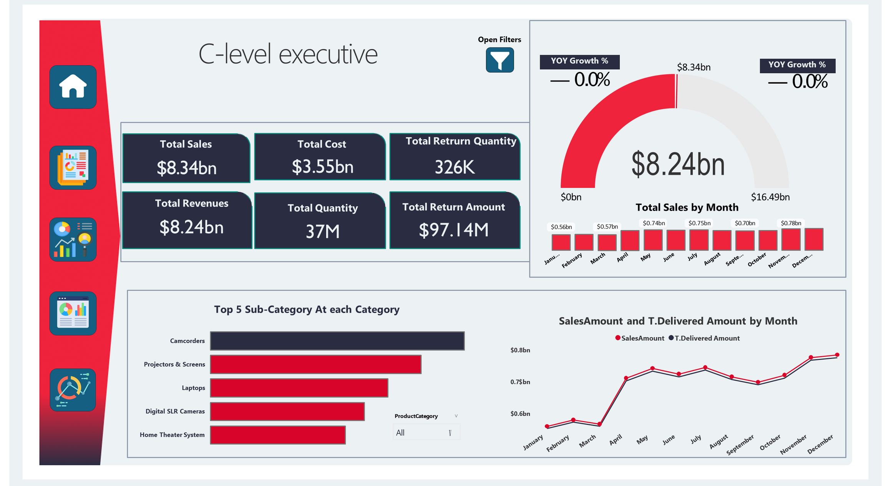
C-level executives

Slide 4
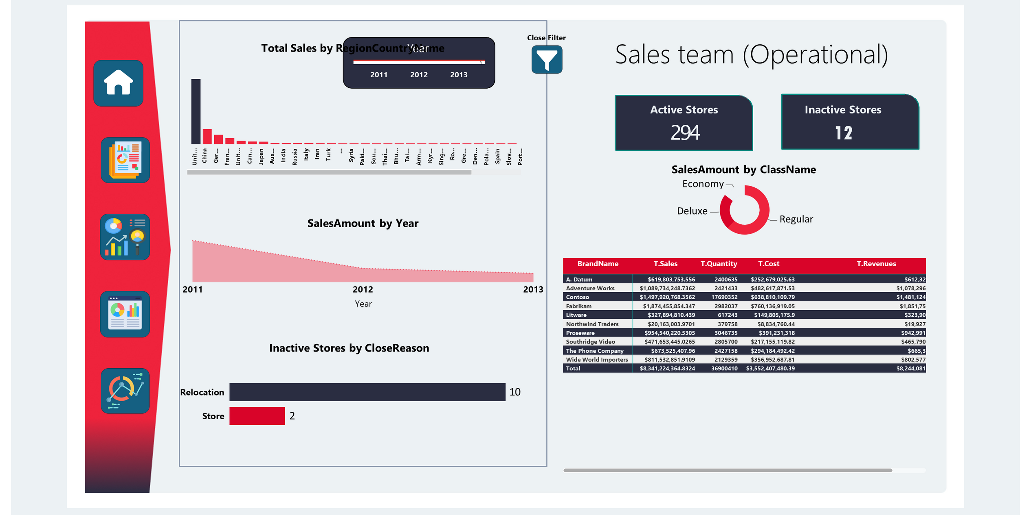
sales team (Operational

Slide 5
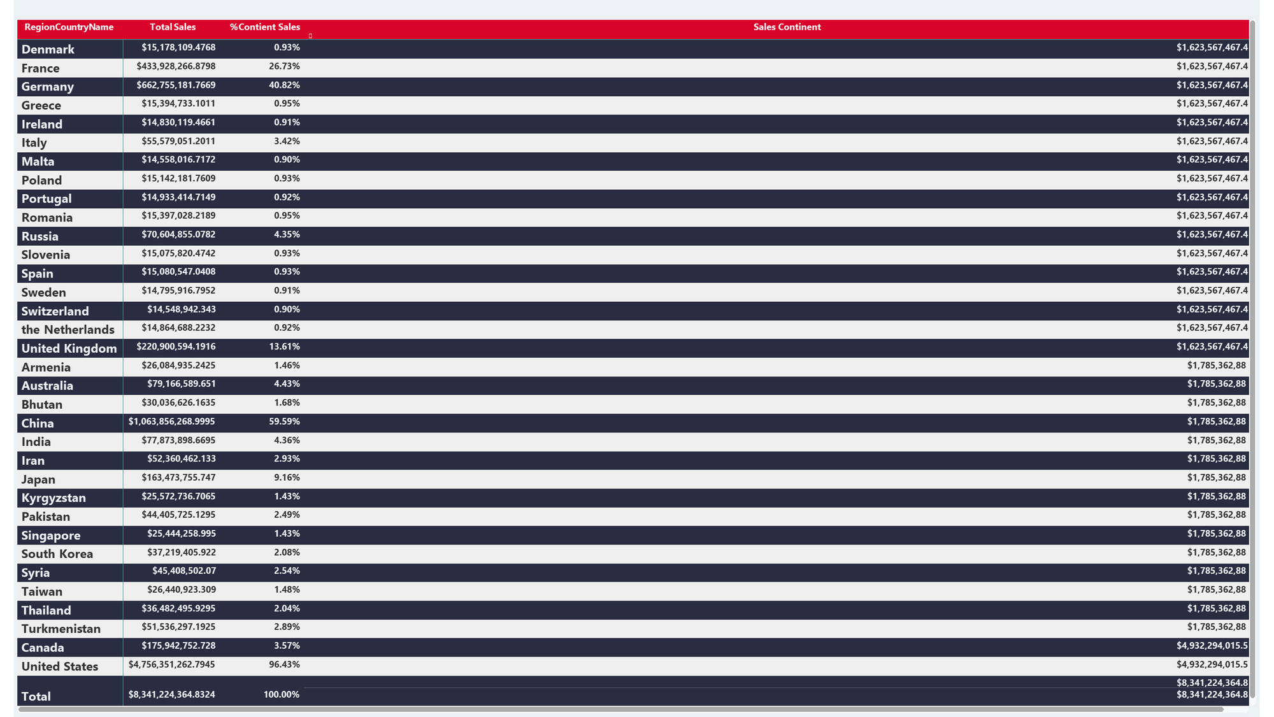
Sales Contient

Slide 6
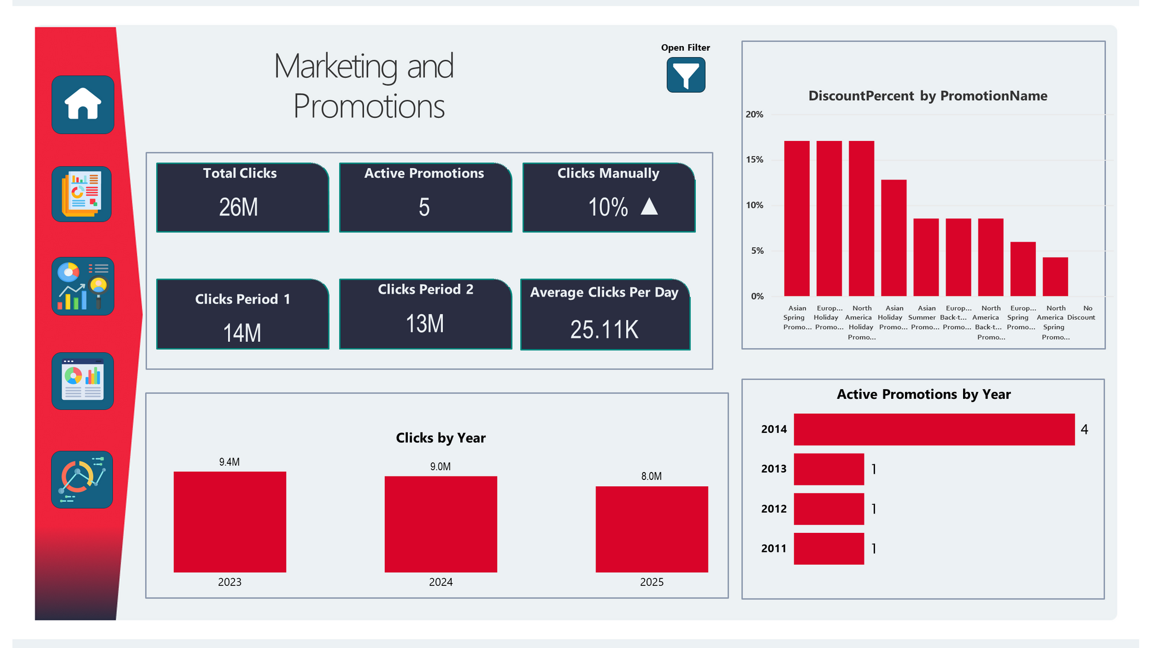
Maketing and Promotions

Slide 7
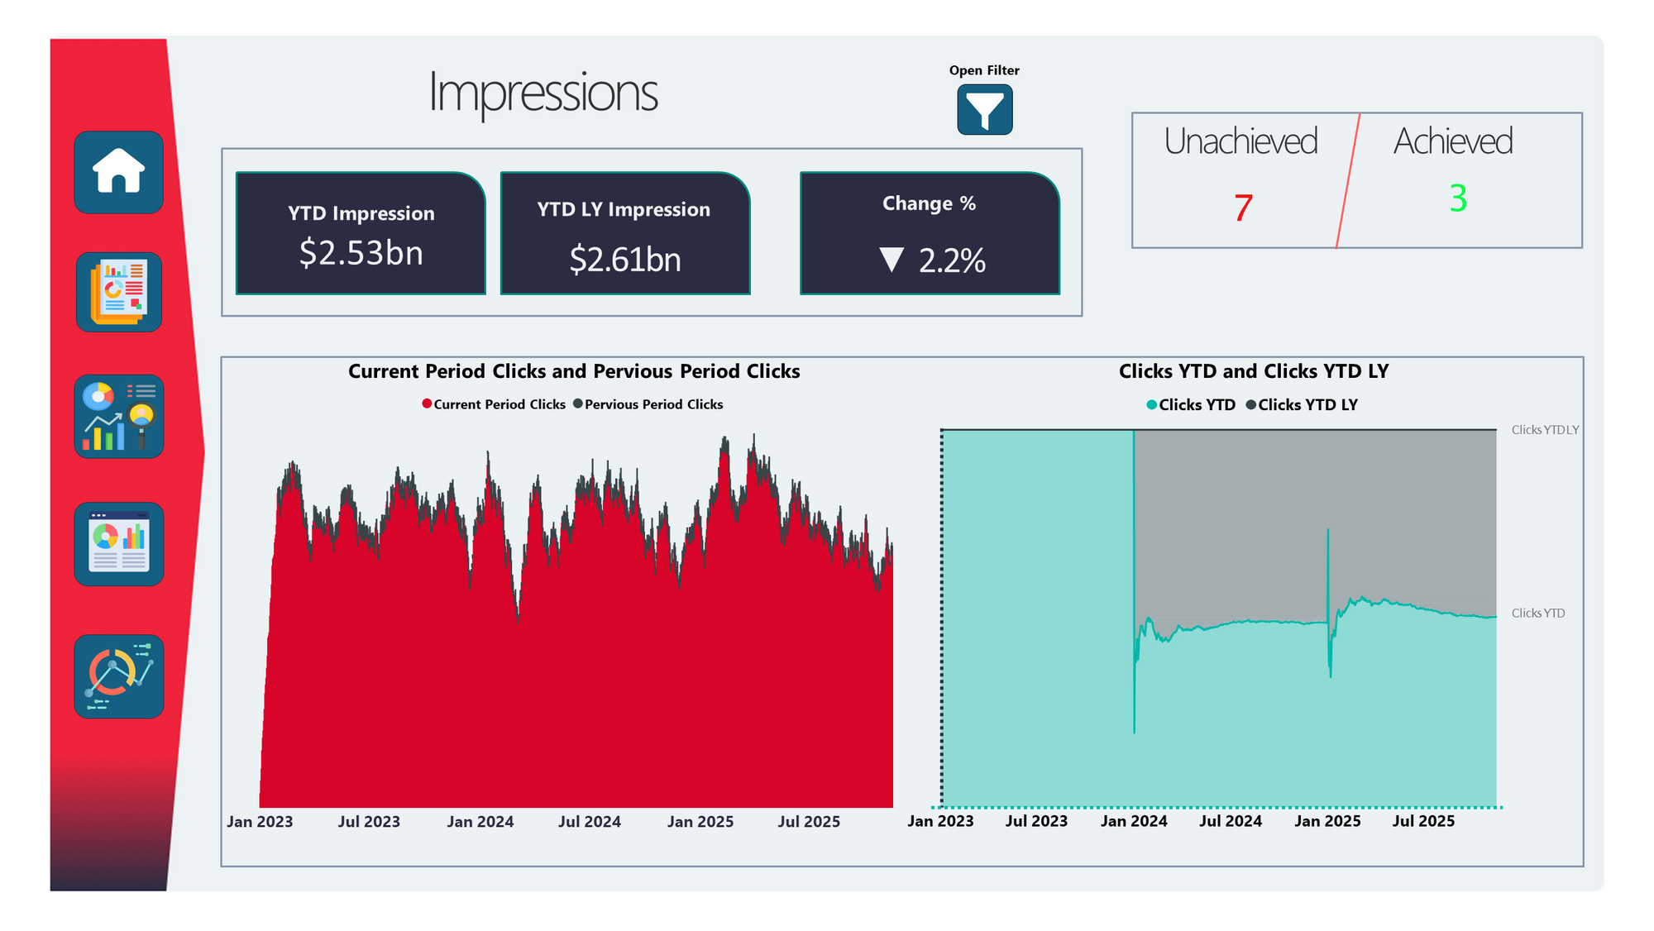
Impressions

Slide 8
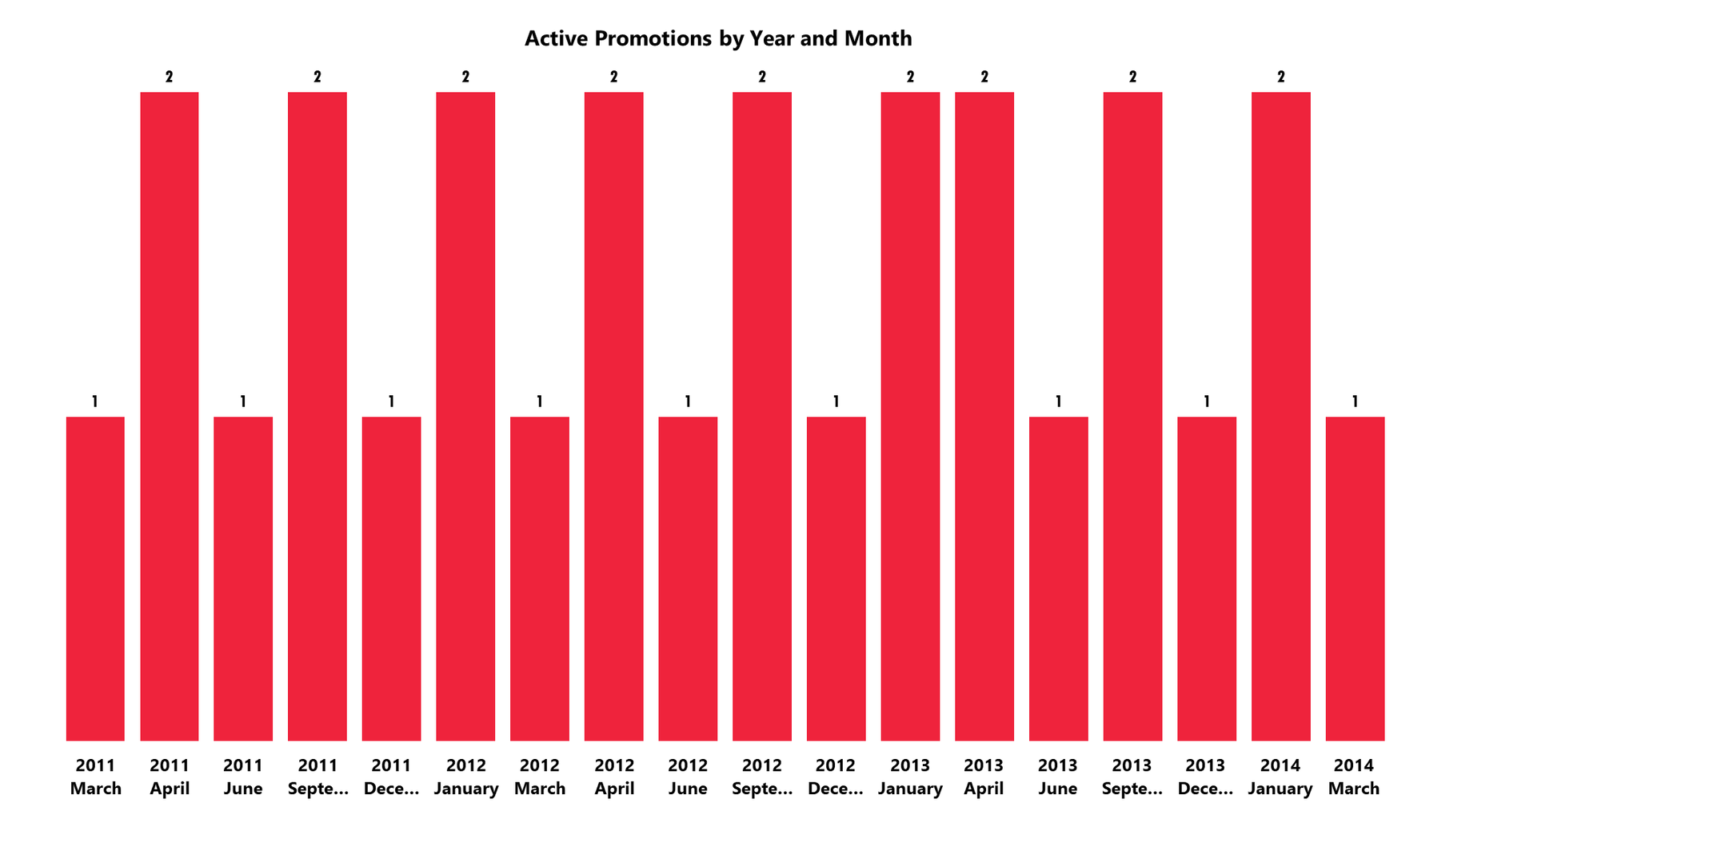
Active Promotions

Slide 9
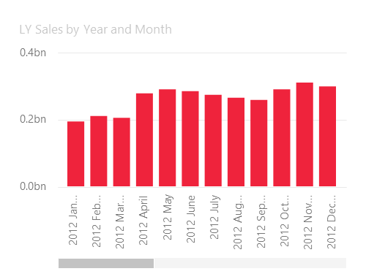
ToolTip

Slide 10
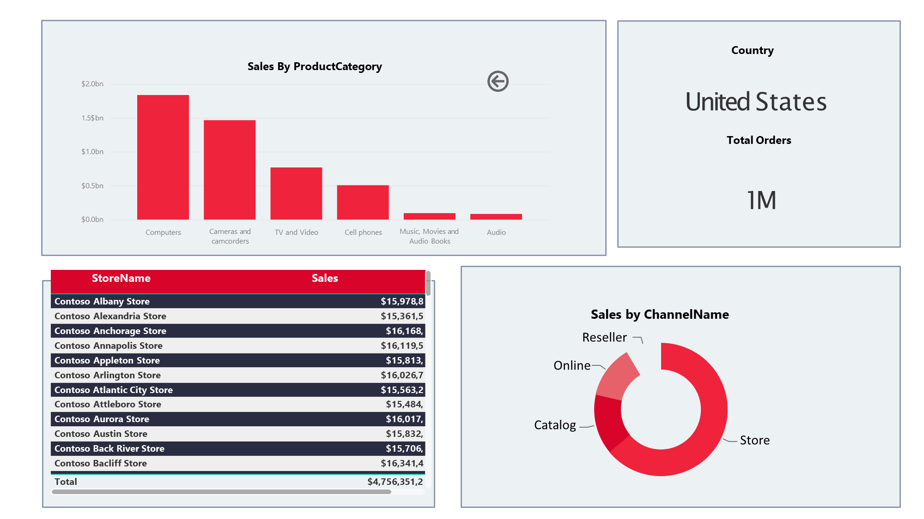
DrillThrough

Slide 11
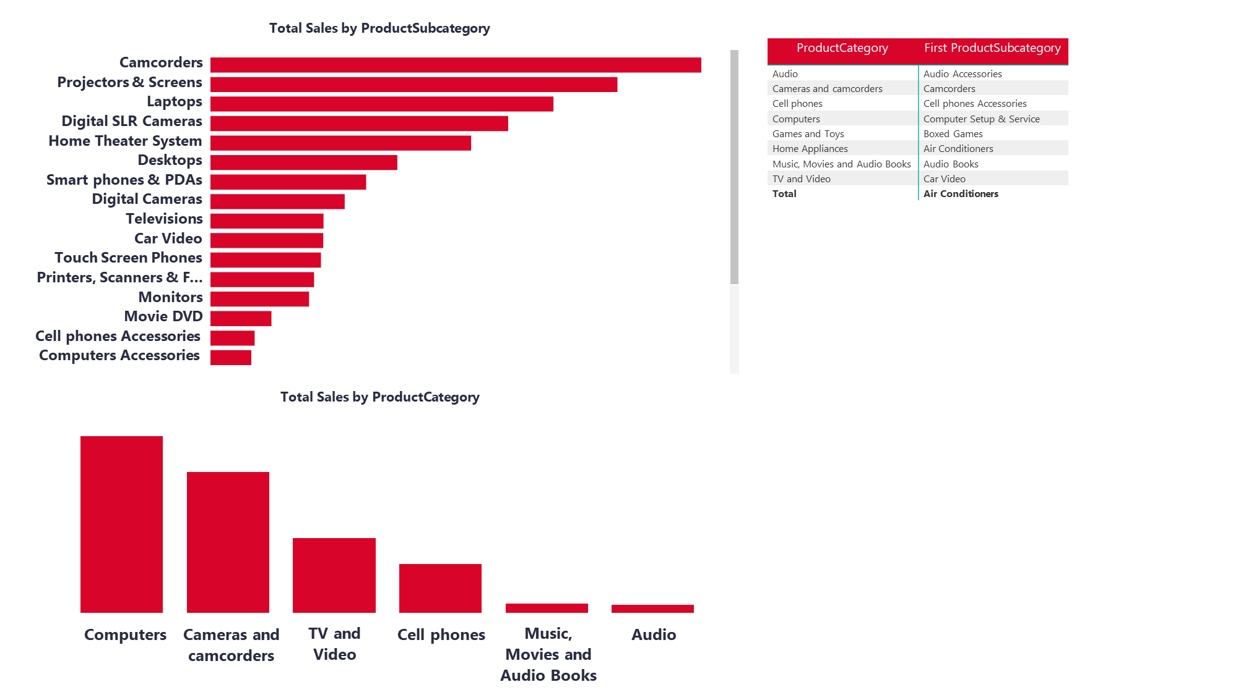
RLS

Slide 12
RECOMMENDATIONS
:
Developing a sales expansion strategy in Europe and Asia to reduce geographical risks.
:
A comprehensive review of quality, shipping, and product description processes to reduce the total amount of returns.
:
:
Increase the marketing and inventory budget for the top five sub-product categories.
:
Conduct an audit of marketing channels and adjust "YTD Impression" campaigns that are prone to decline.
:
An in-depth study of Fabrikam's pricing, distribution, and packaging strategies and their application to weaker-performing brands.

Slide 13
Home
About
Project
Contact
THANK YOU FOR YOUR ATTENTION
Presented By :
Phyllis Schwaiger

